Slide 1

SAP Analytics cloud training
Anurag Bajaj
Shubham Singh
Day 9

Slide 2
Agenda – Day 9
Regression Scenario
Concept of Residuals
Our HR Scenario <next day>
Implementing the Regression Scenario
---Break---
Time Series Scenario
Introduction to segmented time series
Segmented TimeSeries Scenario Introduction
www.anubhavtrainings.com

Slide 3

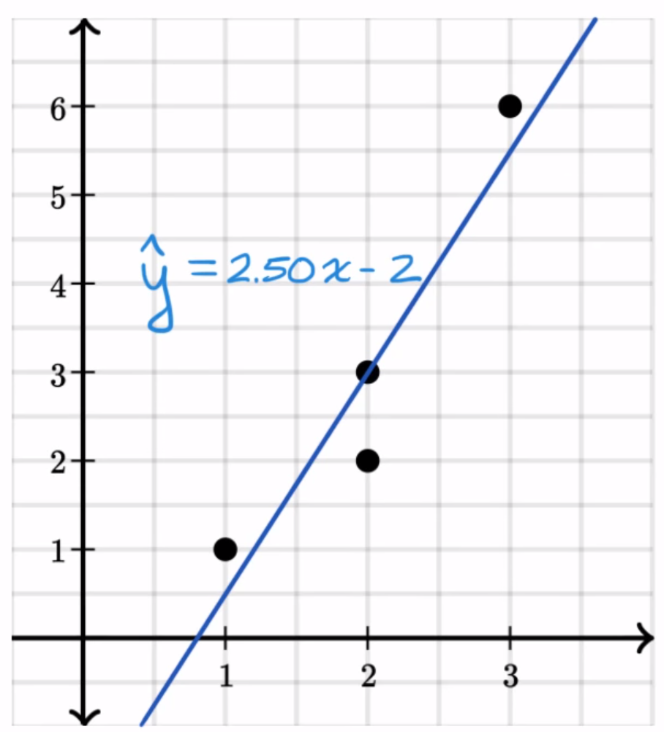
Matrices to check regression quality
How far our actual values are from predicted values. – Residual / deviation
www.anubhavtrainings.com

Slide 4
RMSE & MAPE
RMSD/RMSE – Root mean Square Residual (Error)
The value of RMSE can range between 0 to infinite which is difficult to be interpreted by the business, in order to make our business user understand the power of our model, we relies on a % based measure. This is called MAPE (Meal Absolute Percentage Error)
www.anubhavtrainings.com

Slide 5
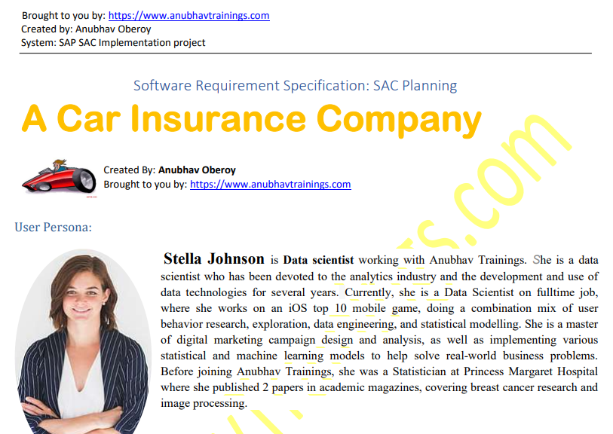
Regression Scenario
www.anubhavtrainings.com

Slide 6
Segmented Time Series
Our goal is to determine target variable which is of continuous nature we use the Segmented time series. The Time series has following differences as compared to Regression
The Trend
The X axis is always Time function
When we want to segmentize the values, Segment is also known as entity.
Trend
Cycles
Fluctuations and Noise
www.anubhavtrainings.com

Slide 7
Time Series Demo Scenario
Please refer the specification document shared by Anubhav.
Create a current Dataset
Create a new model – Simple Story – As of now what's the state
Create a new predictive scenario
And choose segment(Entity) as State
Create a Segmented Time Series Predictive Model for REVENUE
Copy the model and repeat for EXPENDITURE
We will create 2 Data sets, 1 BI Model for Each Dataset
Finally show the Revenue and Exp. In our existing Dashboard
www.anubhavtrainings.com

Slide 8
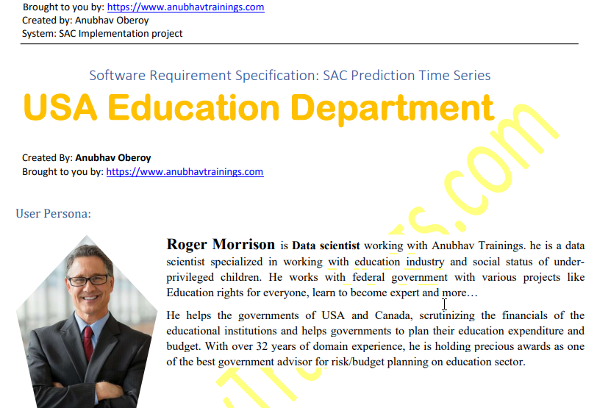
Time Series Scenario
www.anubhavtrainings.com

Slide 9
End of Day 9
www.anubhavtrainings.com

Slide 11

Questions
www.anubhavtrainings.com

Slide 12

Anurag Bajaj
anurag.bajaj02@gmail.com

